Slide 1
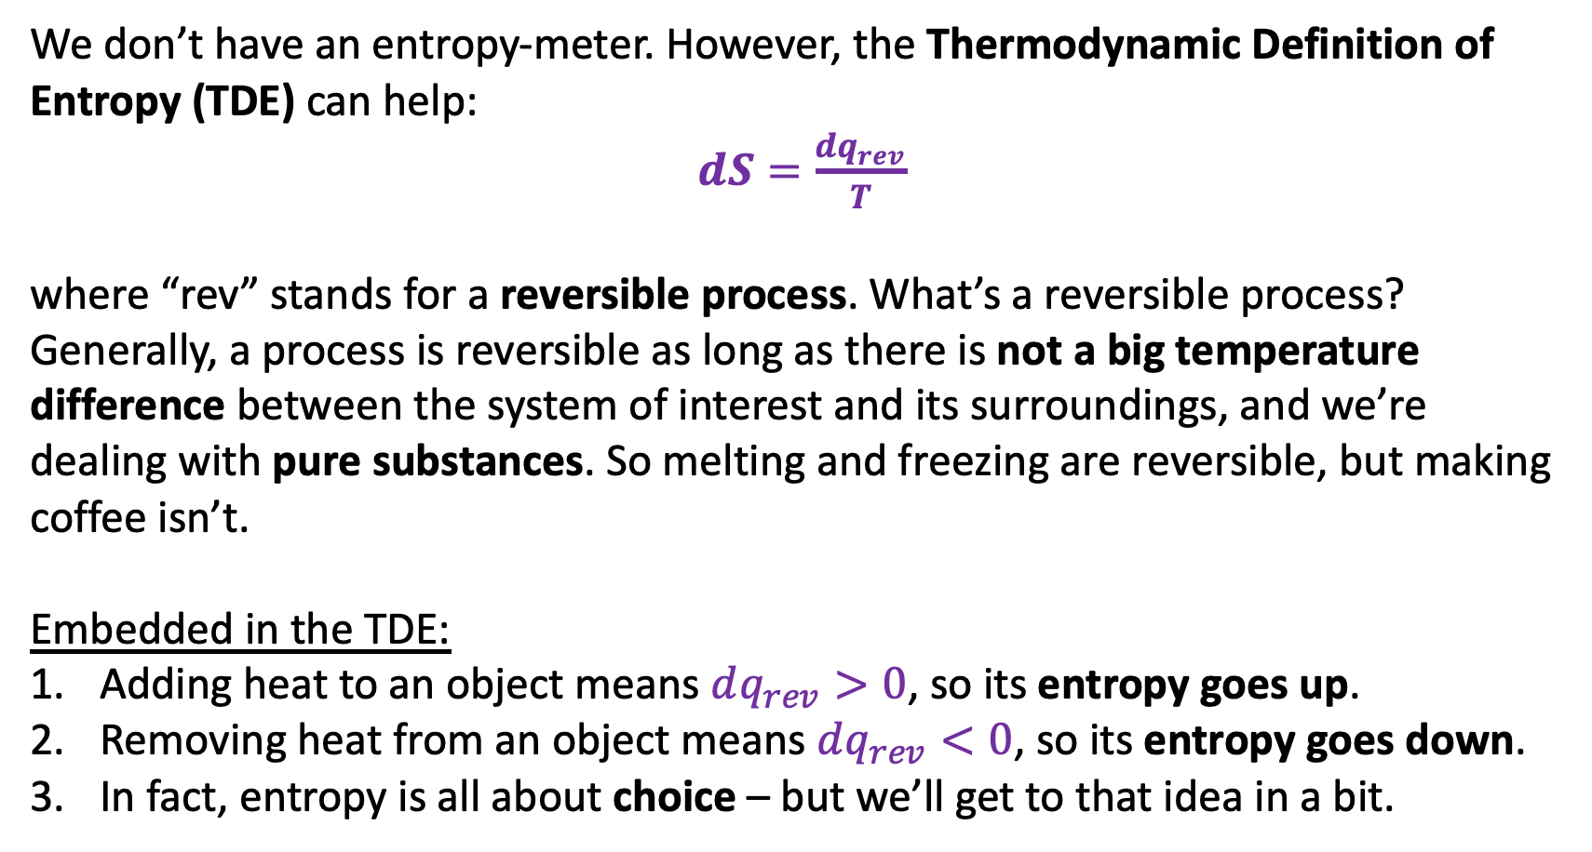
Thermodynamic Definition of Entropy (TDE)
We don’t have an entropy-meter. However, the Thermodynamic Definition of Entropy (TDE) can help:
$dS=\frac{dq_{rev}}{T}$
where “rev” stands for a reversible process. What’s a reversible process? Generally, a process is reversible as long as there is not a big temperature difference between the system of interest and its surroundings, and we’re dealing with pure substances. So melting and freezing are reversible, but making coffee isn’t.
Embedded in the TDE:
Adding heat to an object means $dq_{rev}>0$, so its entropy goes up.
Removing heat from an object means $dq_{rev}<0$, so its entropy goes down.
In fact, entropy is all about choice – but we’ll get to that idea in a bit.

Slide 2
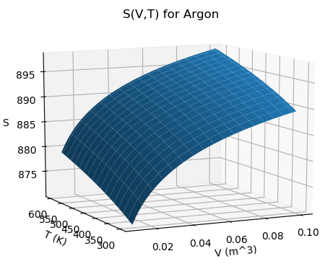



S(T,V)
$${\left(\frac{∂S}{∂T}\right)}_{V}$$
Obvious that entropy of this substance (it’s a gas) goes up with temperature and with volume … let’s understand the temperature dependence first.
$${\left(\frac{∂S}{∂V}\right)}_{T}$$
$$dS={{\left(\frac{∂S}{∂T}\right)}_{V}dT+ \left(\frac{∂S}{∂V}\right)}_{T}dV$$

Slide 3

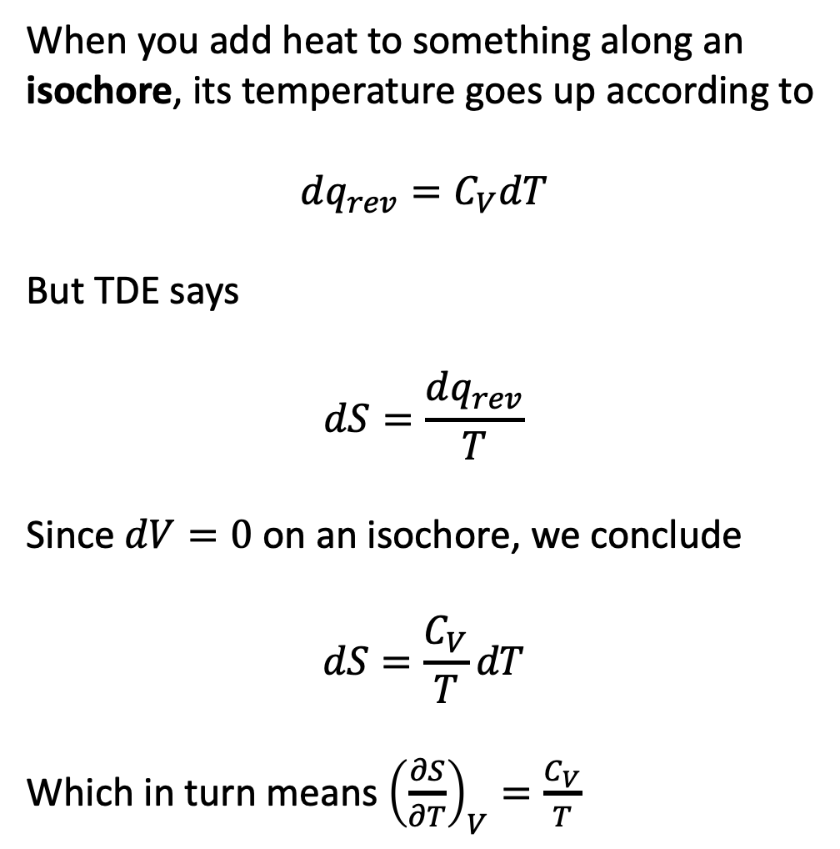
Heating along an isochore
When you add heat to something along an isochore, its temperature goes up according to
$$dq_{rev}=C_{V}dT$$
But TDE says
$$dS=\frac{dq_{rev}}{T}$$
Since $dV=0$ on an isochore, we conclude
$$dS=\frac{C_{V}}{T}dT$$
Which in turn means ${\left(\frac{∂S}{∂T}\right)}_{V}=\frac{C_{V}}{T}$
$${\left(\frac{∂S}{∂T}\right)}_{V}$$
$${\left(\frac{∂S}{∂V}\right)}_{T}$$
$$dS={{\left(\frac{∂S}{∂T}\right)}_{V}dT+ \left(\frac{∂S}{∂V}\right)}_{T}dV$$

Slide 4

Heating along an isochore
When you add heat to something along an isochore, its temperature goes up according to
$$dq_{rev}=C_{V}dT$$
But TDE says
$$dS=\frac{dq_{rev}}{T}$$
Since $dV=0$ on an isochore, we conclude
$$dS=\frac{C_{V}}{T}dT$$
Which in turn means ${\left(\frac{∂S}{∂T}\right)}_{V}=\frac{C_{V}}{T}$
$${\left(\frac{∂S}{∂T}\right)}_{V}$$
$${\left(\frac{∂S}{∂V}\right)}_{T}$$
$$dS={\frac{C_{V}}{T}dT+ \left(\frac{∂S}{∂V}\right)}_{T}dV$$

Slide 5
Heating along an isochore
When you add heat to something along an isochore, its temperature goes up according to
$$dq_{rev}=C_{V}dT$$
But TDE says
$$dS=\frac{dq_{rev}}{T}$$
Since $dV=0$ on an isochore, we conclude
$$dS=\frac{C_{V}}{T}dT$$
Which in turn means ${\left(\frac{∂S}{∂T}\right)}_{V}=\frac{C_{V}}{T}$
$${\left(\frac{∂S}{∂T}\right)}_{V}$$
$${\left(\frac{∂S}{∂V}\right)}_{T}$$
$$dS={\frac{C_{V}}{T}dT+ \left(\frac{∂S}{∂V}\right)}_{T}dV$$
You should probably commit this to memory

Slide 6
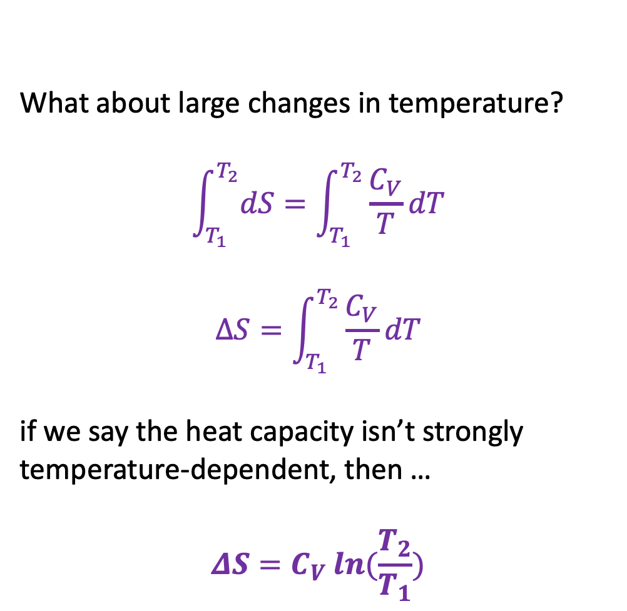
Heating along an isochore
What about large changes in temperature?
$$\int_{T_{1}}^{T_{2}}{dS}=\int_{T_{1}}^{T_{2}}{\frac{C_{V}}{T}dT}$$
$$∆S=\int_{T_{1}}^{T_{2}}{\frac{C_{V}}{T}dT}$$
if we say the heat capacity isn’t strongly temperature-dependent, then …
$$ΔS=C_{V} ln⁡(\frac{T_{2}}{T_{1}})$$
$${\left(\frac{∂S}{∂T}\right)}_{V}$$
$${\left(\frac{∂S}{∂V}\right)}_{T}$$
$$dS={\frac{C_{V}}{T}dT+ \left(\frac{∂S}{∂V}\right)}_{T}dV$$
You should probably commit this to memory too

Slide 7
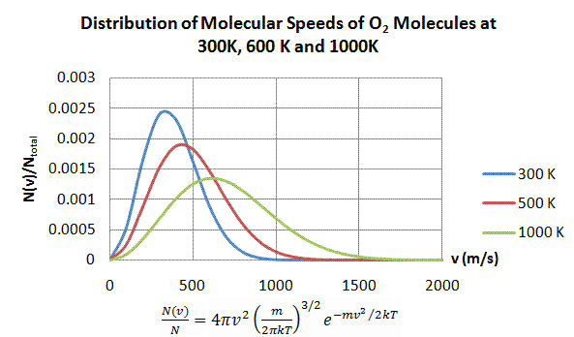
How higher temperatures lead to greater choice, hence more entropy
These speeds are unavailable at 500 K
Higher T => wider distribution of speeds => more possibilities (choices) of how molecules “choose” a speed

Slide 8
How higher temperatures lead to greater choice, hence more entropy
But available at 1000 K
Higher T => wider distribution of speeds => more possibilities (choices) of how molecules “choose” a speed

Slide 9
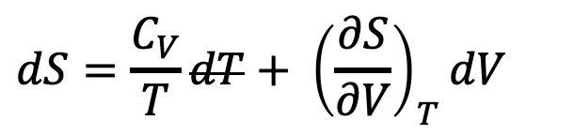
What about isothermal expansion?
This is isothermal expansion
More positional choice
$$dS={\frac{C_{V}}{T}dT+ \left(\frac{∂S}{∂V}\right)}_{T}dV$$

Slide 10
What about isothermal expansion?
This is isothermal expansion
More positional choice
$$dS={\frac{C_{V}}{T}dT+ \left(\frac{∂S}{∂V}\right)}_{T}dV$$
${\left(\frac{∂S}{∂V}\right)}_{T}$ turns out to equal $\frac{α_{P}}{κ_{T}}$ (we’ll prove this later)

Slide 11
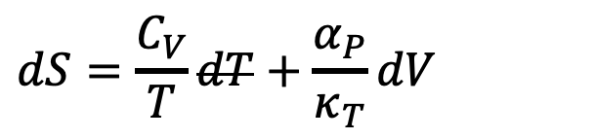
What about isothermal expansion?
This is isothermal expansion
More positional choice
$$dS=\frac{C_{V}}{T}dT+\frac{α_{P}}{κ_{T}}dV$$
${\left(\frac{∂S}{∂V}\right)}_{T}$ turns out to equal $\frac{α_{P}}{κ_{T}}$ (we’ll prove this later)

Slide 12
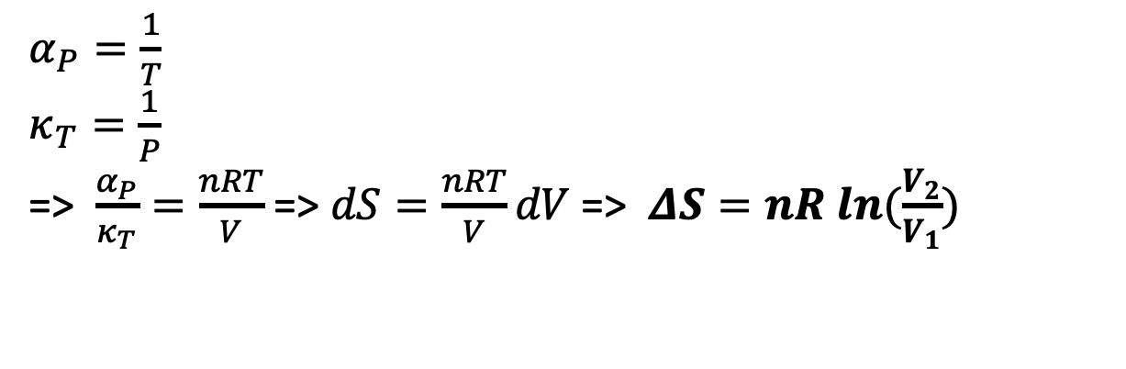
Special Thermodynamics: isothermal expansion of an ideal gas
This is isothermal expansion
More positional choice
$$dS=\frac{C_{V}}{T}dT+\frac{α_{P}}{κ_{T}}dV$$
$α_{P}=\frac{1}{T}$
$κ_{T}=\frac{1}{P}$
=> $\frac{α_{P}}{κ_{T}}=\frac{nRT}{V}$ => $dS=\frac{nRT}{V}dV$ => $ΔS=nR ln⁡(\frac{V_{2}}{V_{1}})$
You should probably commit this to memory too

Slide 13
Special Thermodynamics: isothermal expansion of an ideal gas
2x more positional choice
$$dS=\frac{C_{V}}{T}dT+\frac{α_{P}}{κ_{T}}dV$$
Say we double the size of a box containing 1 mole of gas.
Answer: $ΔS=R ln\left(\frac{2}{1}\right)=+5.8\frac{J}{mol∙K}$.

Slide 14
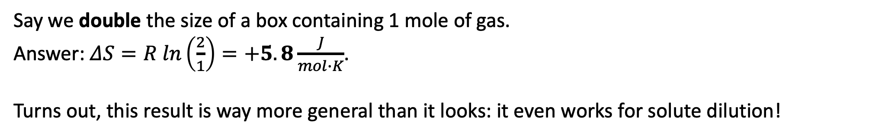
Special Thermodynamics: isothermal expansion of an ideal gas
2x more positional choice
$$dS=\frac{C_{V}}{T}dT+\frac{α_{P}}{κ_{T}}dV$$
Say we double the size of a box containing 1 mole of gas.
Answer: $ΔS=R ln\left(\frac{2}{1}\right)=+5.8\frac{J}{mol∙K}$.
Turns out, this result is way more general than it looks: it even works for solute dilution!

Slide 15
Special Thermodynamics: isothermal expansion of an ideal gas
1000x more positional choice
What if the increase is a factor of 1000 (like, if we’re vaporizing a liquid).
Answer: $ΔS≈57\frac{J}{mol∙K}$.

Slide 16


Summary
$${\left(\frac{∂S}{∂T}\right)}_{V}$$
$${\left(\frac{∂S}{∂V}\right)}_{T}$$
Temperature:
Entropy increases with temperature because of more energy choice
If heat capacity is constant, the increase is logarithmic with respect to temperature
Volume:
Entropy increases with volume because of positional choice
If it’s an ideal gas, the increase is logarithmic with respect to volume

Slide 17
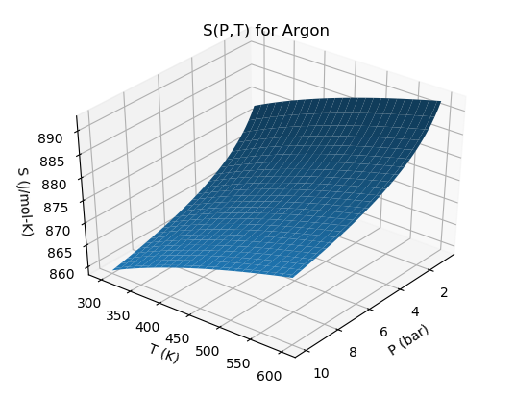
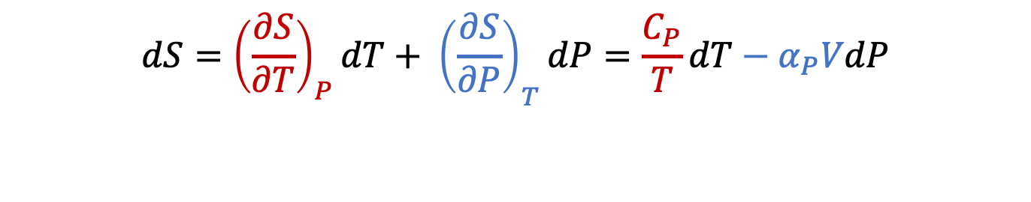


S(T,P)
$${\left(\frac{∂S}{∂P}\right)}_{T}$$
$${\left(\frac{∂S}{∂T}\right)}_{P}$$
$$dS={{\left(\frac{∂S}{∂T}\right)}_{P}dT+ \left(\frac{∂S}{∂P}\right)}_{T}dP=\frac{C_{P}}{T}dT−α_{P}VdP$$

Slide 18
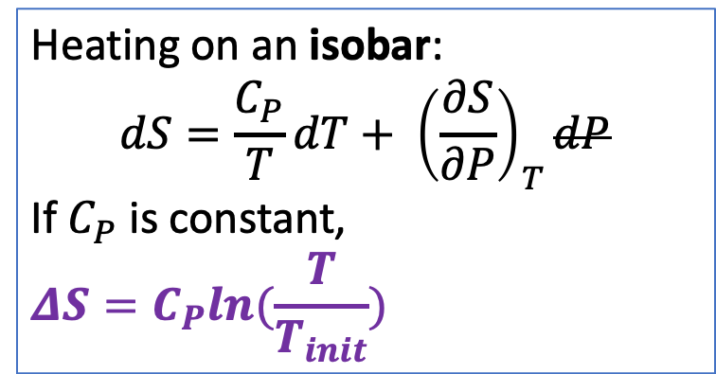
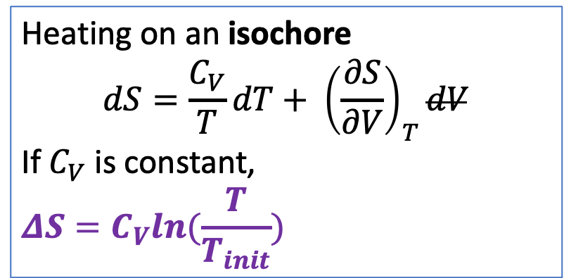
Get logarithmic increase in entropy with respect to temperature for isobaric heating too
Heating on an isochore
$$dS={\frac{C_{V}}{T}dT+ \left(\frac{∂S}{∂V}\right)}_{T}dV$$
If $C_{V}$ is constant,
$$ΔS=C_{V}ln⁡(\frac{T}{T_{init}})$$
Heating on an isobar:
$$dS=\frac{C_{P}}{T}{dT+ \left(\frac{∂S}{∂P}\right)}_{T}dP$$
If $C_{P}$ is constant,
$$ΔS=C_{P}ln⁡(\frac{T}{T_{init}})$$
isobaric
S
isochoric
T

Slide 19


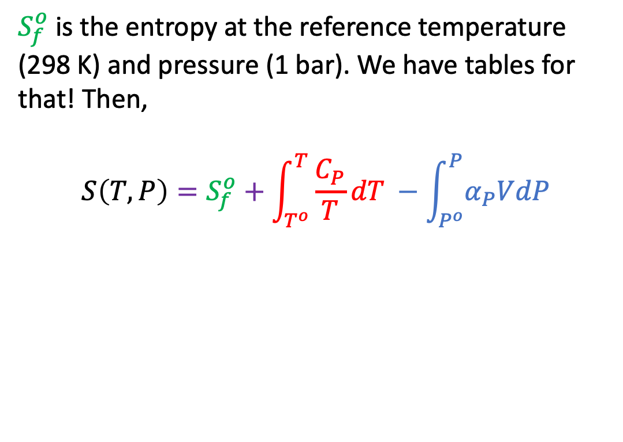
To get the entropy at a given temperature and pressure, we need a starting point ($S_{f}^{o}$)
$$S_{f}^{o}$$
$S_{f}^{o}$ is the entropy at the reference temperature (298 K) and pressure (1 bar). We have tables for that! Then,
$$S\left(T,P\right)=S_{f}^{o}+\int_{T^{o}}^{T}{\frac{C_{P}}{T}dT} −\int_{P^{o}}^{P}{α_{P}VdP}$$
$$S\left(T,P\right)$$

Slide 20
To get the entropy at a given temperature and pressure, we need a starting point ($S_{f}^{o}$)
$$S_{f}^{o}$$
$S_{f}^{o}$ is the entropy at the reference temperature (298 K) and pressure (1 bar). We have tables for that! Then,
$$S\left(T,P\right)=S_{f}^{o}+\int_{T^{o}}^{T}{\frac{C_{P}}{T}dT} −\int_{P^{o}}^{P}{α_{P}VdP}$$
$$S\left(T,P\right)$$
We can do something with this if it’s an ideal gas

Slide 21
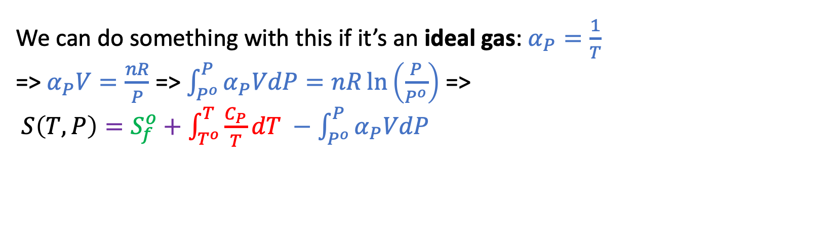
To get the entropy at a given temperature and pressure, we need a starting point ($S_{f}^{o}$)
$$S_{f}^{o}$$
$S_{f}^{o}$ is the entropy at the reference temperature (298 K) and pressure (1 bar). We have tables for that! Then,
$$S\left(T,P\right)=S_{f}^{o}+\int_{T^{o}}^{T}{\frac{C_{P}}{T}dT} −\int_{P^{o}}^{P}{α_{P}VdP}$$
$$S\left(T,P\right)$$
We can do something with this if it’s an ideal gas: $α_{P}=\frac{1}{T}$
=> $α_{P}V=\frac{nR}{P}$ => $\int_{P^{o}}^{P}{α_{P}VdP}=nR\ln\left(\frac{P}{P^{o}}\right)$ =>
$S\left(T,P\right)=S_{f}^{o}+\int_{T^{o}}^{T}{\frac{C_{P}}{T}dT} −\int_{P^{o}}^{P}{α_{P}VdP}$

Slide 22
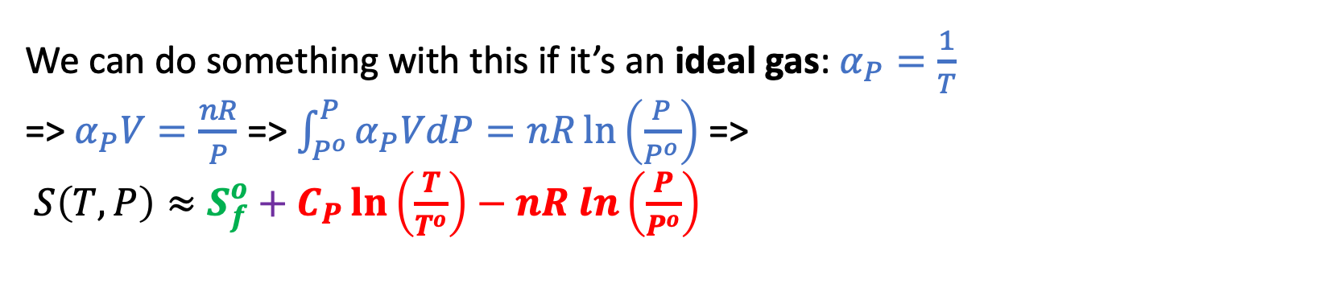
To get the entropy at a given temperature and pressure, we need a starting point ($S_{f}^{o}$)
$$S_{f}^{o}$$
$S_{f}^{o}$ is the entropy at the reference temperature (298 K) and pressure (1 bar). We have tables for that! Then,
$$S\left(T,P\right)=S_{f}^{o}+\int_{T^{o}}^{T}{\frac{C_{P}}{T}dT} −\int_{P^{o}}^{P}{α_{P}VdP}$$
$$S\left(T,P\right)$$
We can do something with this if it’s an ideal gas: $α_{P}=\frac{1}{T}$
=> $α_{P}V=\frac{nR}{P}$ => $\int_{P^{o}}^{P}{α_{P}VdP}=nR\ln\left(\frac{P}{P^{o}}\right)$ =>
$S\left(T,P\right)≈S_{f}^{o}+C_{P}\ln\left(\frac{T}{T^{o}}\right)−nR ln\left(\frac{P}{P^{o}}\right)$

Slide 23
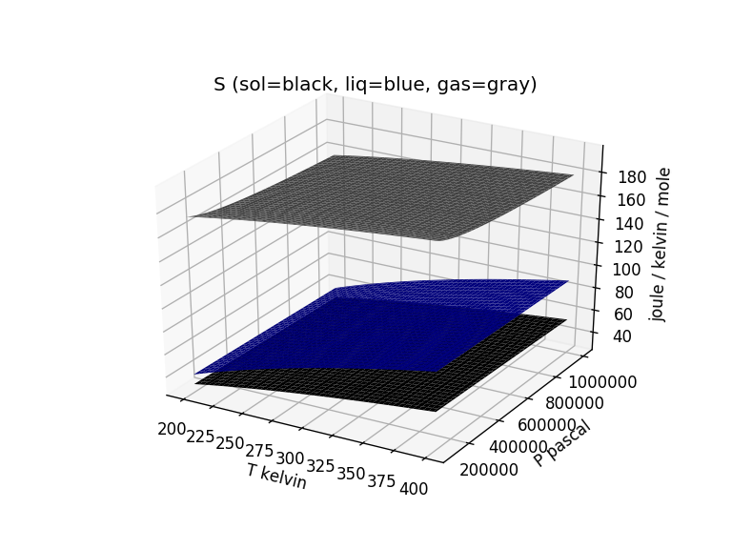
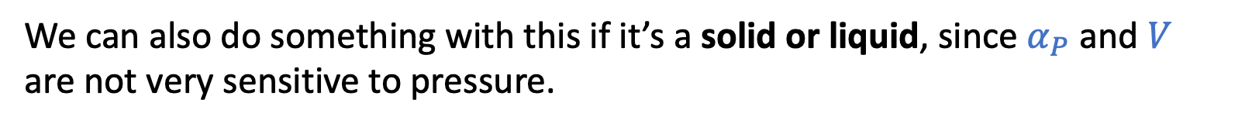
To get the entropy at a given temperature and pressure, we need a starting point ($S_{f}^{o}$)
$S_{f}^{o}$ is the entropy at the reference temperature (298 K) and pressure (1 bar). We have tables for that! Then,
$$S\left(T,P\right)=S_{f}^{o}+\int_{T^{o}}^{T}{\frac{C_{P}}{T}dT} −\int_{P^{o}}^{P}{α_{P}VdP}$$
We can also do something with this if it’s a solid or liquid, since $α_{P}$ and $V$ are not very sensitive to pressure.

Slide 24
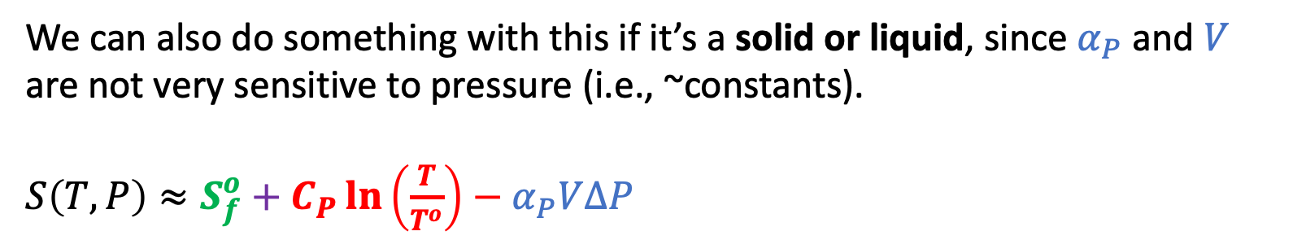
To get the entropy at a given temperature and pressure, we need a starting point ($S_{f}^{o}$)
$S_{f}^{o}$ is the entropy at the reference temperature (298 K) and pressure (1 bar). We have tables for that! Then,
$$S\left(T,P\right)=S_{f}^{o}+\int_{T^{o}}^{T}{\frac{C_{P}}{T}dT} −\int_{P^{o}}^{P}{α_{P}VdP}$$
We can also do something with this if it’s a solid or liquid, since $α_{P}$ and $V$ are not very sensitive to pressure (i.e., ~constants).
$S\left(T,P\right)≈S_{f}^{o}+C_{P}\ln\left(\frac{T}{T^{o}}\right)−α_{P}V∆P$

Slide 25
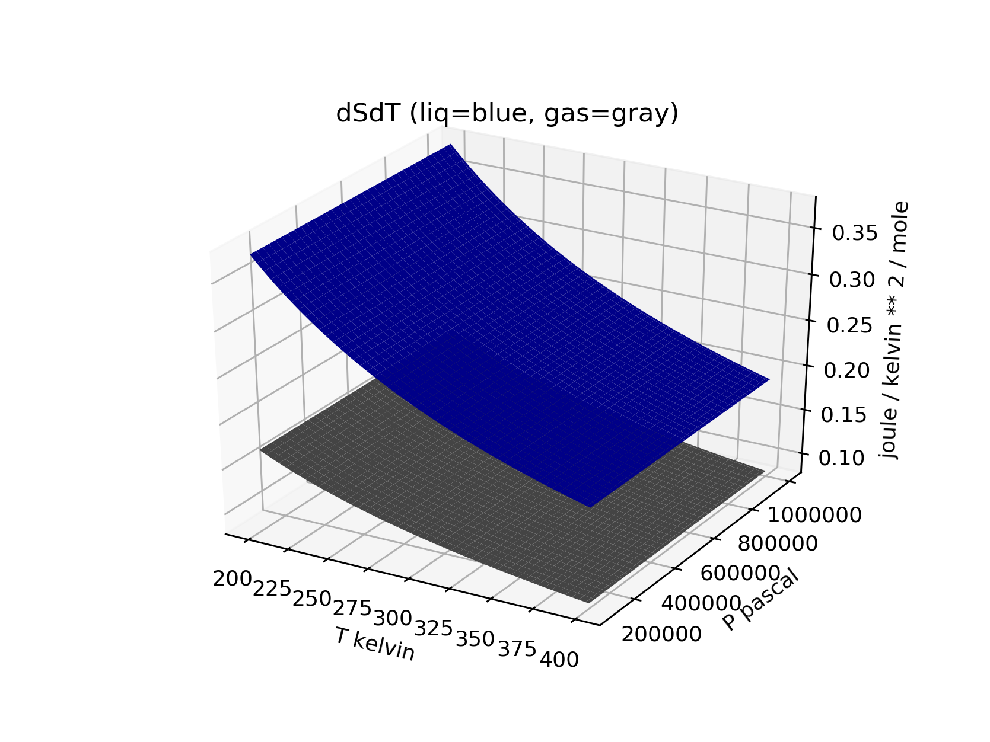
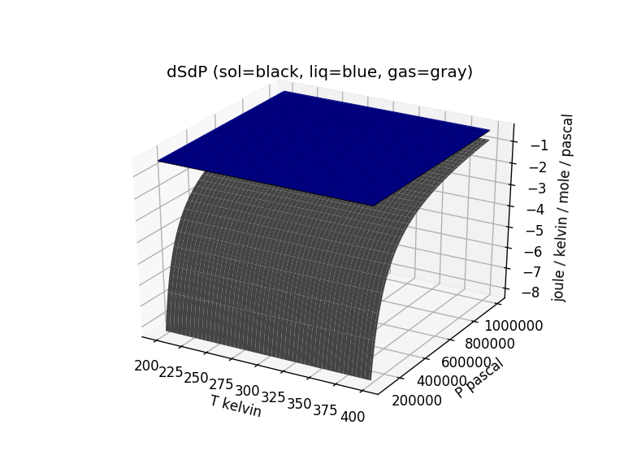
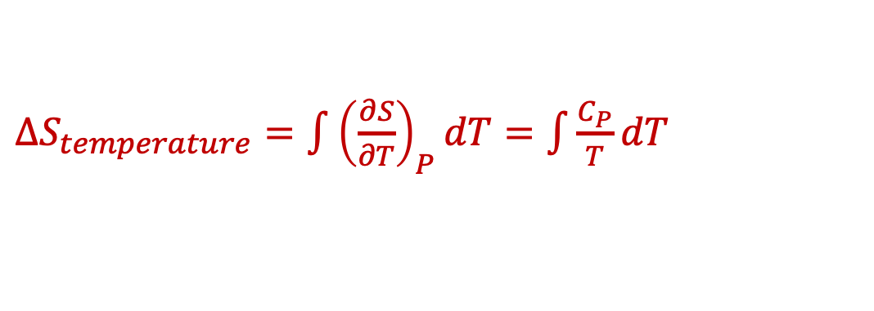
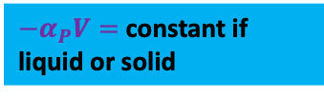





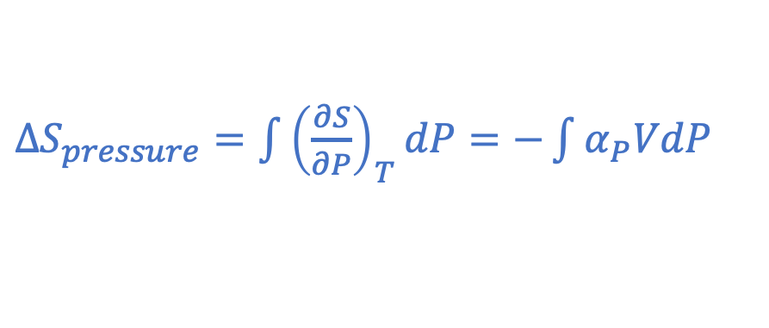

The CGI on this focuses on $S(T,P)$ and $∆S_{trs}(T,P)$ …
${−α}_{P}V=$constant if liquid or solid
$\frac{C_{P}}{T}$
${−α}_{P}V= −\frac{R}{P}$ if a gas
$${−α}_{P}V$$
$∆S_{temperature}=\int{{\left(\frac{∂S}{∂T}\right)}_{P}dT}=\int{\frac{C_{P}}{T}dT}$
$∆S_{pressure}=\int{{\left(\frac{∂S}{∂P}\right)}_{T}dP}=−\int{α_{P}VdP}$
$${\left(\frac{∂S}{∂P}\right)}_{T}$$
$${\left(\frac{∂S}{∂T}\right)}_{P}$$
$$S=S_{f}^{o}+ ∆S_{temperature}+∆S_{pressure}$$

